Slide 1

TEAM ASSIGNMENT 7
Software Measurement and Analysis
Team : K15T1_Team11
Project Name: Course SMA

Slide 2


TEAM MEMBERS
1. Le Dinh Thach Huyen (Member)
Dang Huy Son (Sub-Leader)
Do Minh Tam (Recorder)
Nguyen Trung Tin (Member)
Le Thi Bich Van (Leader)

Slide 3


CONTENTS
1. Goal of a Project Budget
  2. Criterion for the feasibility
3. Breakdown & Analysis Budget
4. Budget Estimated Breakdown Chart
5. Recommend

Slide 4
GOAL OF PROJECT BUDGET
One of the key elements of any project proposal is the project budget
The project manager will use this budget to determine whether the project is on track
Project personnel will use it as a guideline to fulfill certain project milestones

Slide 5
CRITERTION FOR THE FEASIBILITY
Index | Criterion
ROI | < 20%: Project can’t implementation >= 20%: Project is ready for implementation
Total Payback Period | More than 3 years: Project can’t implementation Less than 3 years: Project is ready for implementation
NPV | < 0: Project can’t implementation <= 20% (investment): Project is viable >20% (investment): Project is good for investment
Breakeven Analysis | >6000 (License) & >3000 (Dev License): It is not realistic

Slide 6
BREAKDOWN & ANALYSIS BUDGET
K15T1-Team11-Team Assignment7.xls

Slide 7
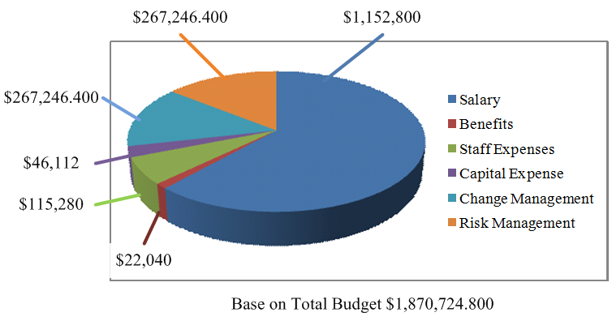
BUDGET ESTIMATED BREAKDOWN CHART

Slide 8
Project is ready implementation
Viking Project | Criterion
ROI = 85.37% > 20% | < 20%: Project can’t implementation >= 20%: Project is ready for implementation
Total Payback Period : 1 years and 7 months less than 3 years | More than 3 years: Project can’t implementation Less than 3 years: Project is ready for implementation
NPV = $1,326,560.891, or131,37% investment | < 0: Project can’t implementation <= 20% (investment): Project is viable >20% (investment): Project is good for investment
Breakeven Analysis : 2399 (License) < 6000 & 801 (Dev License) < 3000 | >6000 (License) & >3000 (Dev License): It is not realistic

Slide 9




